Slide 1

Types of Social Entrepreneurs & Business Plan
Career Development Centre
SRMIST – kattankulathur

Slide 2
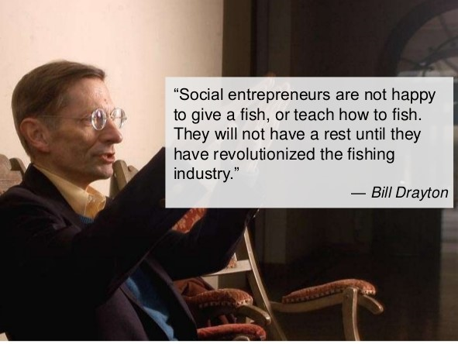
Who is a Social Entrepreneur?
‘Social entrepreneurs are
individuals with innovative
solutions to society’s most
pressing social problems.
They are persistent and
ambitious, tackle major
social issues and offer new
ideas for a wide-scale change.’
Career Development Centre
SRMIST – kattankulathur

Slide 3

Focus of Social Entrepreneur
Career Development Centre
SRMIST – kattankulathur

Slide 4
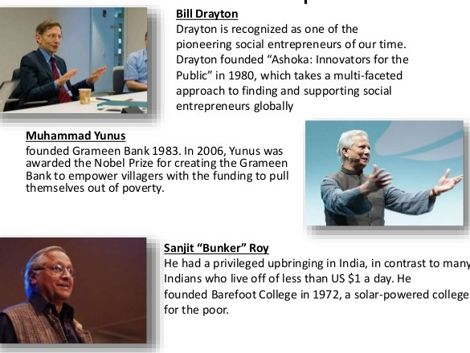
Famous Social Entrepreneurs
Career Development Centre
SRMIST – kattankulathur

Slide 5
Types of Social Entrepreneurs
The Community Social Entrepreneur
The Non-Profit Social Entrepreneur
The Transformational Social Entrepreneur
The Global Social Entrepreneur
Career Development Centre
SRMIST – kattankulathur

Slide 6

The Community Social Entrepreneur
This sort of social
entrepreneur seeks to
create ventures meant
to serve the social needs
of a community within
a relatively narrow
geographical area.
Career Development Centre
SRMIST – kattankulathur

Slide 7

The Non-Profit Social Entrepreneur
These social entrepreneurs
are more focused on social
wealth than material wealth.
Consequently, any profits
made are reinvested into
the business to facilitate
the further expansion of
services offered.
Career Development Centre
SRMIST – kattankulathur

Slide 8

The Transformational Social Entrepreneur
Here, the focus extends to the
Creation of an enterprise able to
meet those social needs not
adequately being met by
governments and other businesses.
These businesses occasionally
evolve into institutions and the
involved social entrepreneur must
have the skills and capacity to
administer a large team .
Career Development Centre
SRMIST – kattankulathur

Slide 9

The Global Social Entrepreneur
The global social
entrepreneur works toward
Complete transformation
of a social system in order
to meet major social needs
and to change the very fabric
of society worldwide.
Career Development Centre
SRMIST – kattankulathur

Slide 10
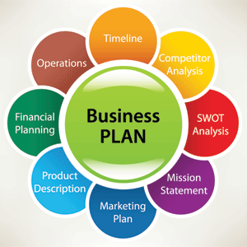
Business Plan
Vision
Mission
Opportunity
Risk
Action Plan
Implementation
Revenue Model
Measurement & Evaluation
Scaling Strategies
Career Development Centre
SRMIST – kattankulathur

Slide 11
Vision
Identify the problem and find a solution for it.
Why is it important?
What is the scale?
What are the contributing factors?
What are the root causes?
Example
One day, all children in this country will have the opportunity to achieve an excellent education .
Career Development Centre
SRMIST – kattankulathur

Slide 12
Mission
4 “M”s of Mission Statements
•Memorable
•Manageable
•Measurable
•Motivational
Your statement of what you will achieve over the long term
Career Development Centre
SRMIST – kattankulathur

Slide 13
Opportunity
Why is it solvable?
What other approaches have been tried and what are their results?
What would the world look like (your vision) if you solved it?
Career Development Centre
SRMIST – kattankulathur

Slide 14
Risks
What could go wrong?
Contextually
Strategically
Programmatically
Financially
How will you mitigate these risks?
Raise and address key risks but do not overdo it
Career Development Centre
SRMIST – kattankulathur

Slide 15
Action Plan
What theory will lead to results you want to achieve?
Assumptions of cause and effect in your logic chain
Inputs → Activities → Outputs → Outcomes→Impact
Career Development Centre
SRMIST – kattankulathur

Slide 16
Contd….
Who are the beneficiaries or customers?
How will you serve them?
What specifically does your program look like?
What initial management and governance structure will you put in place to implement the strategy?
What partnerships or collaborations would be critical or
useful?
What criteria did you use for choosing to become a nonprofit
or for-profit organization?
On what premises (experience/knowledge) did you build your
solution?
With whom and how have you tested your vision?
Career Development Centre
SRMIST – kattankulathur

Slide 17
Revenue Model
At start-up stage:
How much start-up capital do you need?
What sources are available to provide seed capital?
How will you spend it?
How will you acquire capital to go to the next level?
How will you fund scaling the organization?
Career Development Centre
SRMIST – kattankulathur

Slide 18
Measurement and Evaluation
Create a measurement and evaluation/data system and culture.
Indicators should link back to your mission, theory of change and strategy
Adapt measures and process to the stage of the organization
Set and measure interim milestones on the way to longer-term goals
Use measures to improve your program and organization
Career Development Centre
SRMIST – kattankulathur

Slide 19
Scaling Strategies
Grow the organization, launch more sites
Replicate your model using other organizations
Create a social movement
Organize collective action
Change government policy and practice
Considerations of scale:
How do you maximize the value you are trying to create?
How do you balance the “speed of scaling” with program quality to optimize social value creation?
Career Development Centre
SRMIST – kattankulathur

Slide 20

Good Luck
Career Development Centre
SRMIST – KattankulathurCareer

